Slide 1
Happy (Virtual) Thanksgiving!
10 ideas for safely celebrating Thanksgiving with (but apart from) your family and friends!

Slide 2
1. Cook Together!
Host your own online cooking class!
Someone on the call can teach everyone else how to make a thanksgiving recipe.
The recipe could also be a fancy drink like an Apple Cider Ginger Bourbon Smash for a Thanksgiving toast. Leave the alcohol out if you’d prefer a “mocktail!”
Tip: Be sure to send a list of ingredients earlier so everyone has what they need.

Slide 3
2. Coordinate dinner
Have everyone on the video call order takeout from the same place, at the same time so you can eat together even though you’re apart.
You could go traditional with Swiss Chalet or you could try something totally different and adventurous!

Slide 4
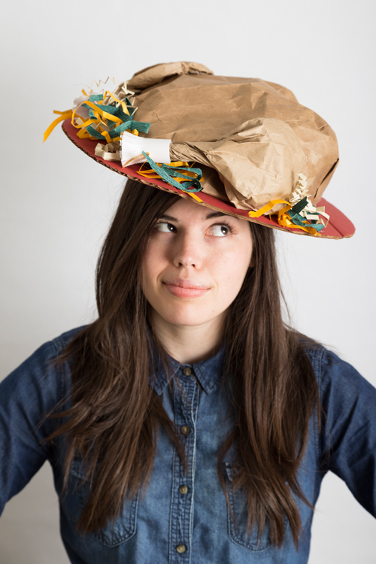
3. Have a dress code
Create a dress code for your virtual party.
It could be as silly as homemade thanksgiving hats or as formal as gowns and neckties.
Just try something different to make it special.

Slide 5
4. Play Jeopardy
You can easily play Jeopardy online if one person shares their screen while running a game from this jeopardylabs.com.
There is a thanksgiving version and an autumn version that would be perfect for this time of year.

Slide 6
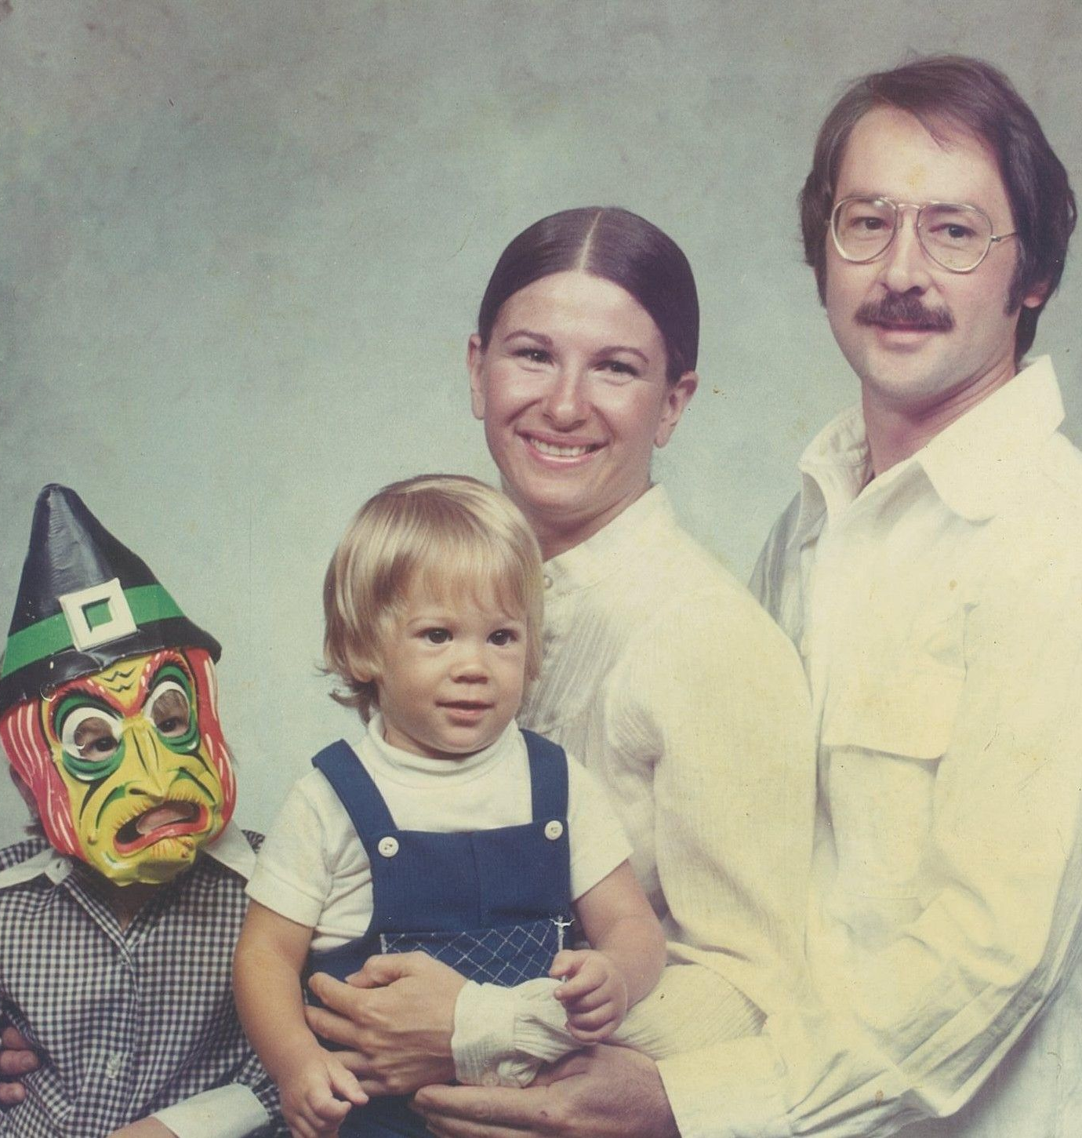
5. Share family memories
Have one person share their screen and look through old family photos together.

Slide 7
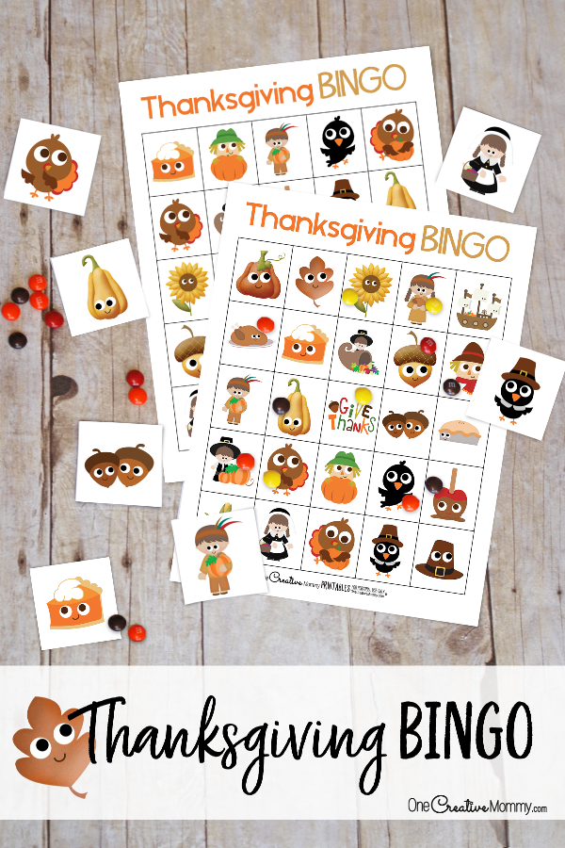
6. Play Thanksgiving bingo
Each person on the video call can download a bingo card to play along.
One person will need to print the calling card and cut out the images.
See full instructions on the website: onecreativemommy.com/best-thanksgiving-bingo-game/

Slide 8
7. Host a watch party!
Pick one of your favourite fall movies and have a watch party on
Netflix,
Disney Plus,
or even YouTube.

Slide 9
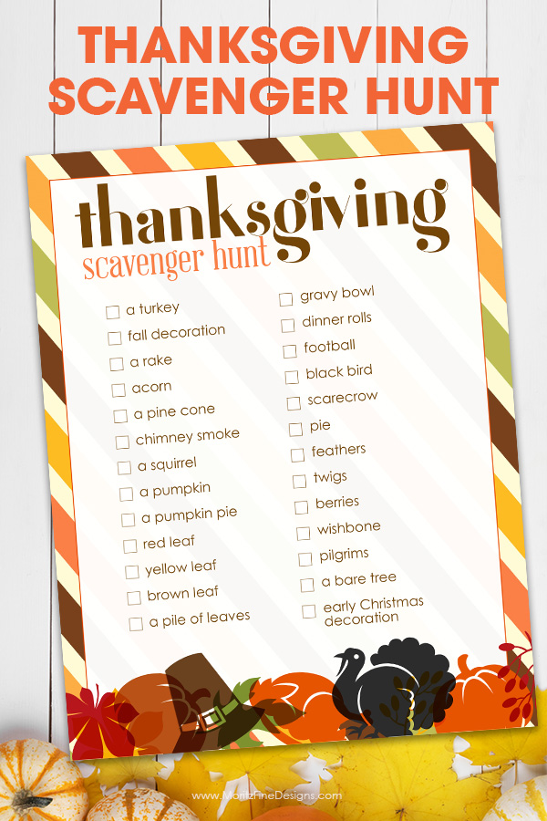
8. Have a scavenger hunt
Virtual scavenger hunts are easy to plan and fun to do.
One person creates a list of items that the others need to find.
They call out an item (for example: “something yellow!”) and everyone rushes to find that item.
The first person to be back on screen showing off their item wins that round.
Here’s a ready-made thanksgiving version that would be perfect.

Slide 10
9. Enjoy some music
If anyone on the call plays a musical instrument, bring it out and enjoy some live music together.
Or, people can take turns suggesting favourite songs to look up on Spotify and everyone can sing or dance along. Dance party!
If you are part of a religious tradition, you likely have songs of thanksgiving or gratitude that you could sing instead, if you prefer. “All Creatures of Our God and King” is one Christian hymn of thanksgiving based on the words of St. Francis of Asisi.

Slide 11
10. Share gratitude!
Create cards or draw pictures for each other showing what you’re thankful for. Show them off during your video call and mail them to each other afterward.
Download this printable page or create your own!
Families of faith may wish to close off their virtual Thanksgiving giving thanks through a time of prayer.

Slide 12
“Gratitude can transform common days into thanksgivings, turn routine jobs into joy, and change ordinary opportunities into blessings.”
-William Athur Ward

Slide 13
Happy Thanksgiving from your friends at

